Slide 1
Web apps development 101 How Internet works
Marek Czarnecki
https://github.com/macmarek/webdev101

Slide 2
What is Internet ?
Internet is largest engineered system ever created by mankind, with hundreds of millions of connected computers, communication links, and switches; with billions of users who connect via laptops, tablets, and smartphones; and with an array of new Internet-connected devices such as sensors

Slide 3
What is Internet ?
3.9 bilion users in 2019
7 billion connected devices in 2019
… and growing …

Slide 4
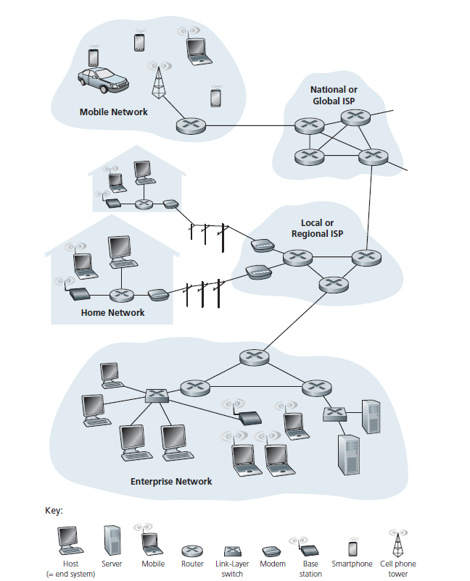
Internet - Nuts and bolts description

Slide 5
Internet – service description
Internet is an infrastructure that provides services to applications. These applications include electronic mail, Web surfing, social networks, instant messaging, Voiceover-IP (VoIP), video streaming, distributed games, peer-to-peer (P2P) file sharing, television over the Internet, remote login, and much, much more. The applications are said to be distributed applications, since they involve multiple end systems that exchange data with each other.

Slide 6
TCP/IP
End systems, packet switches, and other pieces of the Internet run protocols that control the sending and receiving of information within the Internet. The Transmission Control Protocol (TCP) and the Internet Protocol (IP) are two of the most important protocols in the Internet. The IP protocol specifies the format of the packets that are sent and received among routers and end systems. The Internet’s principal protocols are collectively known as TCP/IP.

Slide 7
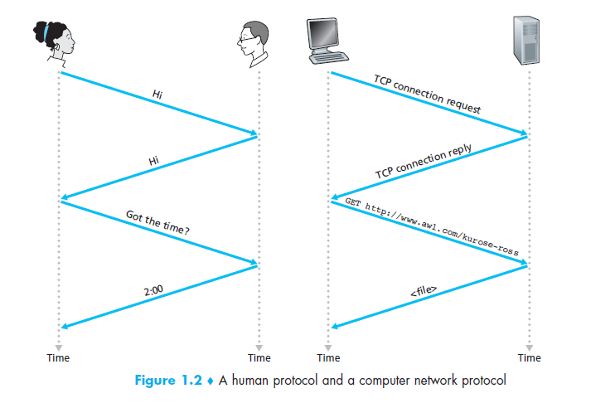
What is protocol ?

Slide 8
Protocol standards
IETF - Internet Engineering Task Force
TCP, IP,
HTTP (for the Web),
SMTP (for e-mail) …
IEEE - Institute of Electrical and Electronics Engineers
802.3x (Ethernet)
802.11 a/b/g/n/.. (WiFi)

Slide 9
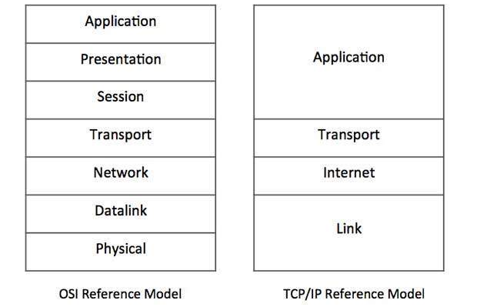

Slide 10
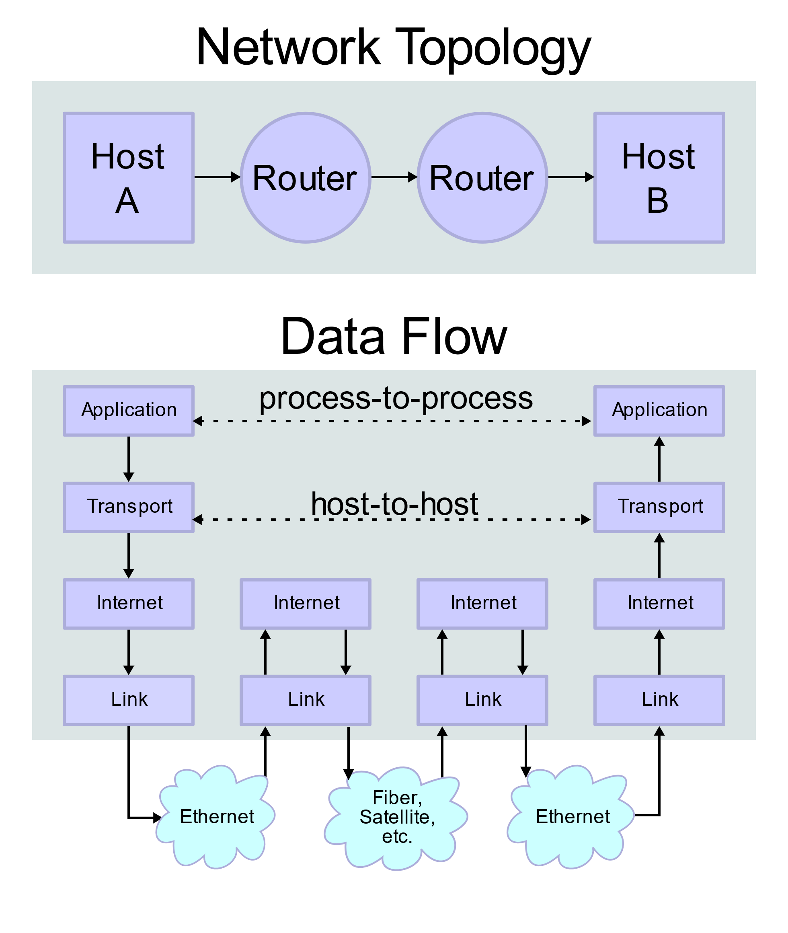

Slide 11
Ip address
We use IP (Internet protocol) address in order to uniquely* reference machines online
172.217.16.35
10101100.11011001.00010000.00100011

Slide 12
IPv4 vs IPv6
IPv4 – 32-bit
Number of IPv4 addresses: 4,294,967,296 (2^32)
Number of public IPv4 addresses: ~3,7 bilion
IPv6 – 128 bit
Number of IPv6 addresses: 2¹²⁸
340,282,366,920,938,463,463,374,607,431,768,211,456, which is approximately 340 undecillion, or 340 billion billion billion billion)

Slide 13
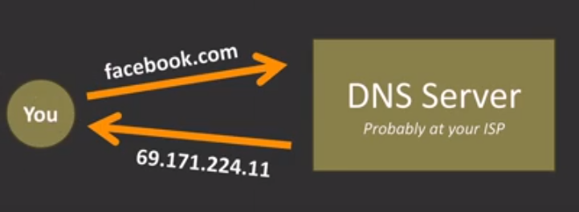
DNS
The Domain Name System (DNS) is a hierarchical and decentralized naming system for computers, services, or other resources connected to the Internet or a private network. It associates various information with domain names assigned to each of the participating entities. Most prominently, it translates more readily memorized domain names to the numerical IP addresses needed for locating and identifying computer services and devices with the underlying network protocols.
google.pl -> 172.217.16.35

Slide 14
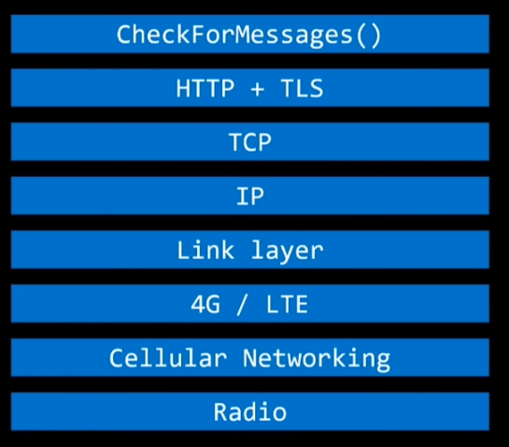
Wireless transmition of an image

Slide 15
Amorphous Internet
Easy to add/remove new systems and the architecture scales without a limit
No single point where Internet exist, and no simple point where you can take the whole thing down for everyone in the world.

Slide 16
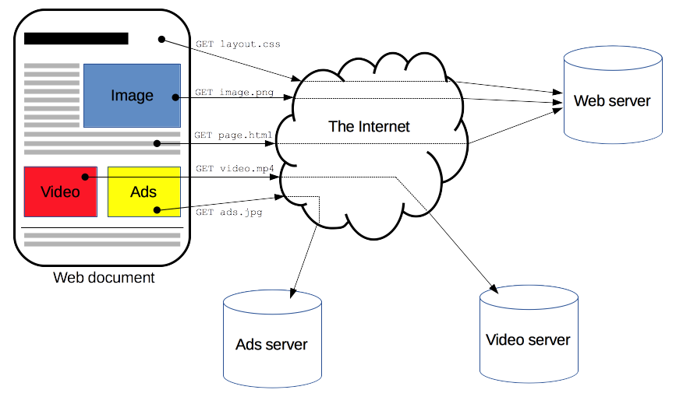
HTTP
HTTP is a protocol which allows the fetching of resources, such as HTML documents. It is the foundation of any data exchange on the Web and it is a client-server protocol, which means requests are initiated by the recipient, usually the Web browser. A complete document is reconstructed from the different sub-documents fetched, for instance text, layout description, images, videos, scripts, and more.

Slide 17
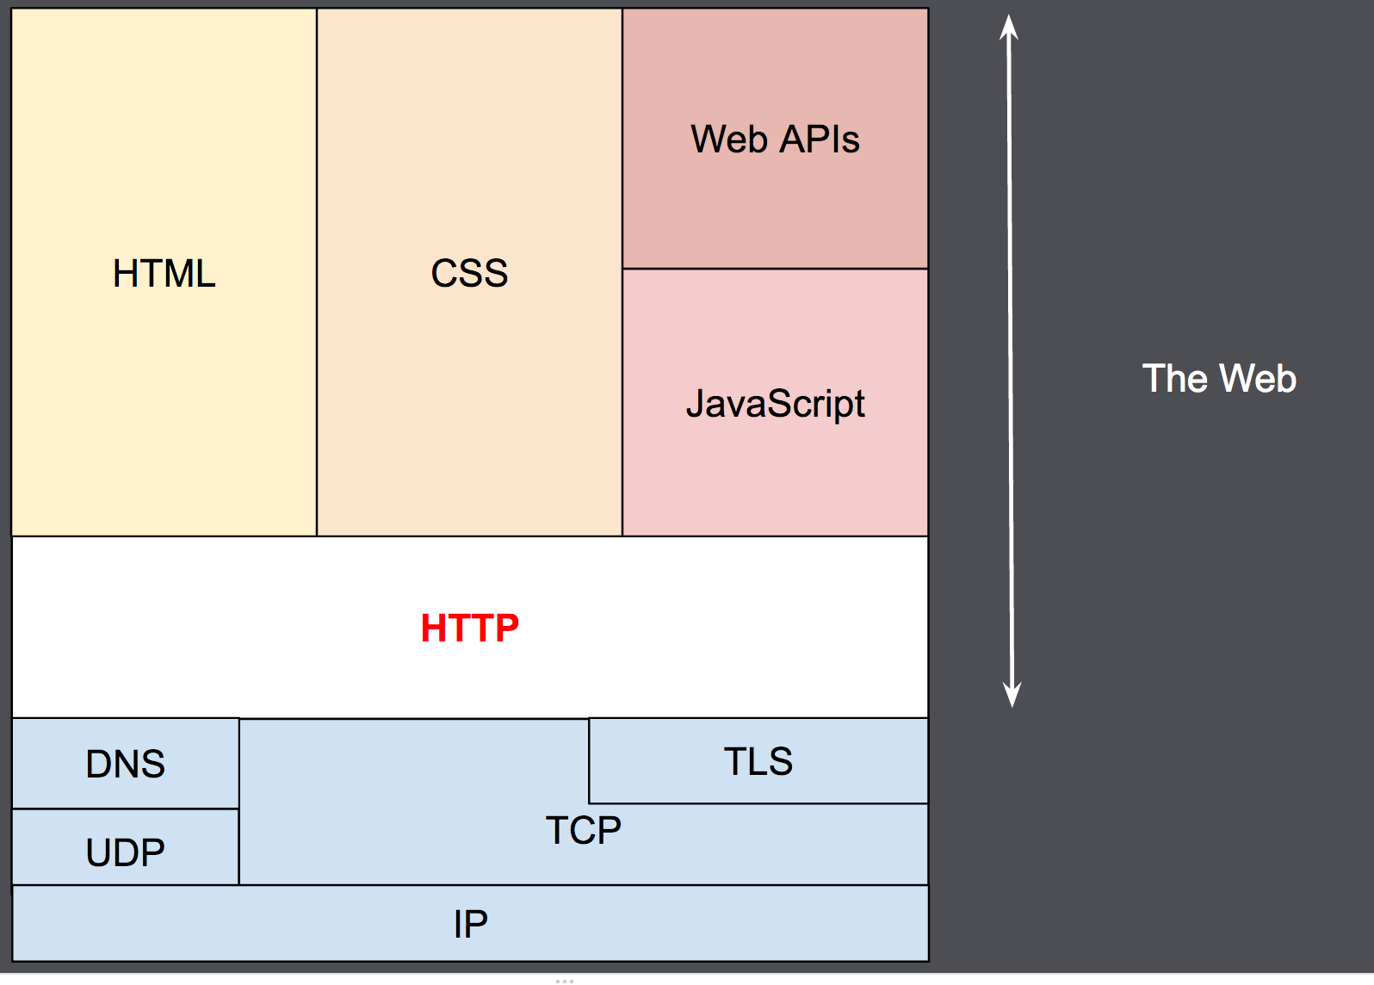
HTTP and layers

Slide 18
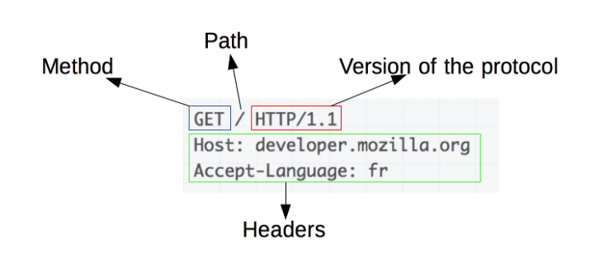
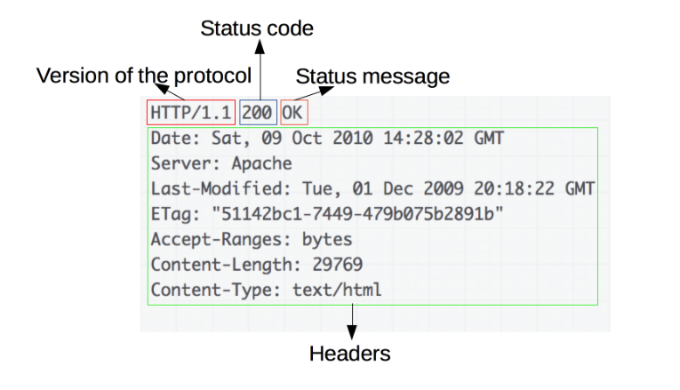
HTTP request and response

Slide 19
HTTP methods
CONNECT
DELETE
GET
HEAD
OPTIONS
PATCH
POST
PUT
TRACE

Slide 20
HTTP methods and CRUD
CONNECT
DELETE (delete)
GET (read)
HEAD
OPTIONS
PATCH
POST (create)
PUT (update)
TRACE

